Slide 1
PREVENTION AND DETECTION OF FAKE CHEQUE
SCAMS USING BLOCK CHAIN
BATCH A13
TEAM MEMBERS
SRIMANJARI P [211418104262]
SUBRINI K B [211418104270]
SWETHA A R [211418104283]
GUIDE NAME: Mrs S.T.SANTHANALAKSHMI. ASSISTANT PROFESSOR(GRADE 1)

Slide 2
INTRODUCTION
In our current society, cheques represent one of the dominant payment methods.
A cheque is an order written by a depositor instructing the bank to pay a specific amount to a recipient from the depositor’s bank account.
Unfortunately, numerous malicious scammers exploit some flaws in the banking system to commit frauds.
Indeed, frauds employing fake cheques are growing rapidly and cost billions of money. we focus on fake cheque scams.
This fraud is achieved getting people mainly through some email scam; establishing a relationship a business relationship most of the time sending them overpaid counterfeit paycheck; and finally asking for the overpayment.

Slide 3
LITERATURE SURVEY
AUTHOR | TITLE | METHODOLOGY | FINDINGS
Badis Hammi , Sherali Zeadally , Yves Christian Elloh Adja, Manlio Del Giudice, and Jamel Nebhen (2021) | Block chain-Based Solution for Detecting and Preventing Fake Check Scams | digital signature algorithm | Digital signatures provide authenticity and ensure that the signature is verified
Emart 77, Beirut, Lebanon (2021) | The Role of Blockchain in Reducing the Cost of Financial Transactions in the Retail Industry | Consumer Packed Goods (CGP) | CPG and some extent, services is arguably one of the most challenging industries to be successful in.
Dilip Kumar Sharma; Sonal Garg; Priya Shrivastava(2021) | Evaluation of Tools and Extension for Fake News Detection | Bi-LSTM classifier. | It is a sequence prediction model.
Vikash Kumar Aggarwal , Nikhil Sharma , Ila Kaushik , Bharat Bhushan ,Himanshu(2020) | Integration of Blockchain and IoT (B-IoT): Architecture, Solutions, & Fuwture Research Direction | Integration of Blockchain and IoT | The smart contract is what allows a smart device to function on its own without the need for a centralized authority
Jackie Jones, Damon McCoy (2020) | The Check is in the Mail: Monetization of Craigslist Buyer Scams. | Conservative Classification Strategy | Compared to manual data entry, automatic data entry greatly reduce errors.
Abiola, Idowu(2019) | An Assessment of Fraud and its Management in Nigeria Commercial Banks. | disadvantage Pearson Product Moment Correlation Coefficient | Acorrelation co effient such as Pearson r is that it provides effect size information (in unit free terms).
Sumeet Kumar(2017) | Simulating DDOS attacks on the us fiber-optics internet infrastructure | cyber- attacks | a network simulation model to understand the Internettraffic flow pattern in a DDoS attack situation
Haris Šemić, Sasa Mrdovic (2017) | IoT honeypot: A multi-component solution for handling manual and Mirai-based attacks | Internet-of-Things (IoT) devices | It is used to attain sufficient exposure to malicious traffic and security of collected data
Bernie S. Fabito, Angelique D. Lacasandile, Emeliza R. Yabut (2017) | Leveraging crime reporting in Metro Manila using unsupervised crowd-sourced data: A case for the Report framework | Ping ER Monitoring Agent | in this framework, contents are addressed through hashes which is a widely used means of connecting data in a distributed network.
Wendy Baker-Smemoe, Chair David Eddington William G. Eggington.(2017) | The Language and Cross-Cultural Perceptions of Deception | Qualtrics Survey Block | Rather than creating two surveys, you could create two blocks of questions within one survey and randomly assign participants to one block or the other.

Slide 4
PROBLEM DEFINITION
The threat of online fraud has spurred many charity companies and financial institutions to alert consumers when potentially fraudulent transactions are made.
Blockchain can help to reduce and even prevent fraud in the supply chain through greater transparency and improved traceability of products.
It’s very difficult to manipulate the blockchain.
In this project bank will return the check leaf to the customer when bank find the charity is fake

Slide 5
DEVELOPMENT ENVIRONMENT
HARDWARE REQUIREMENTS
PROCESSOR : DUAL CORE 2 DUOS
RAM : 2 GB DD RAM
HARD DISK : 250 GB
SOFTWARE REQUIREMENTS
FRONT END : J2EE (JSP, SERVLET)
BACK END : MY SQL 5.5
OPERATING SYSTEM : WINDOWS 7
IDE : ECLIPSE

Slide 6
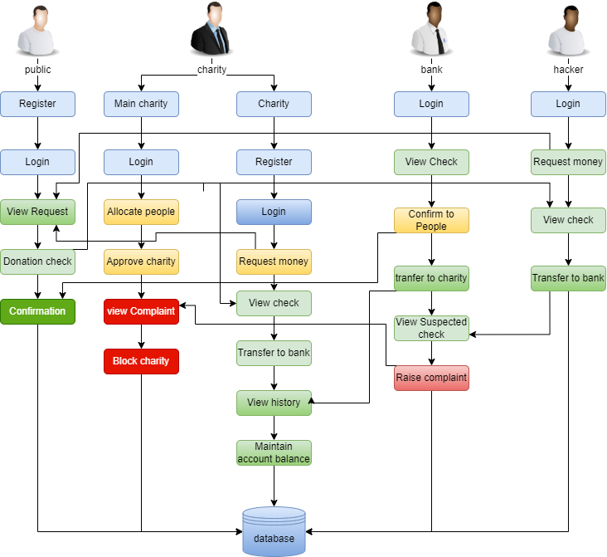
SYSTEM ARCHITECTURE

Slide 7

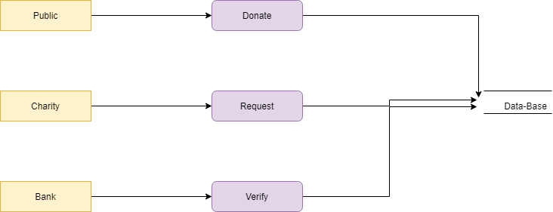
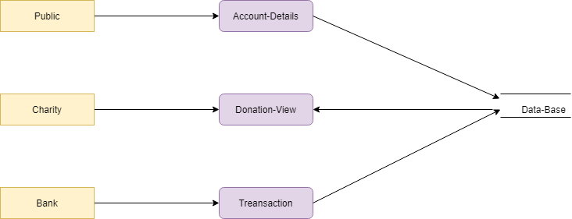
SYSTEM DESIGN
DATAFLOW DIAGRAM
LEVEL 0:
LEVEL 1:
LEVEL 2:

Slide 8
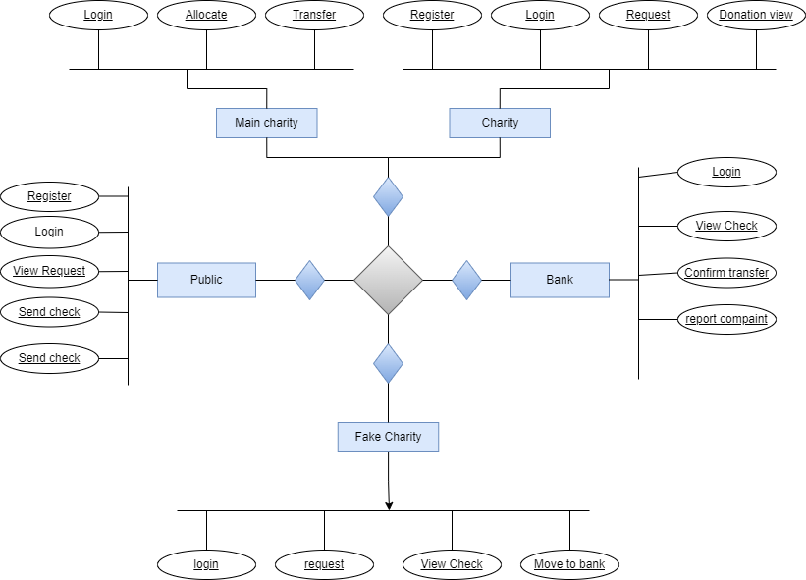
E-R DIAGRAM

Slide 9
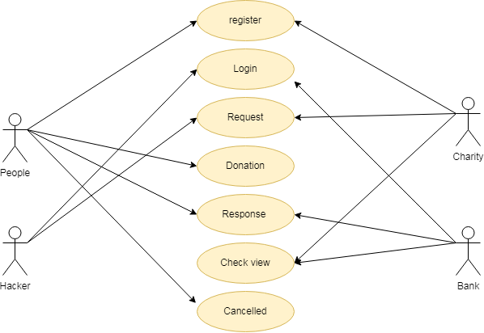
USECASE DIAGRAM

Slide 10
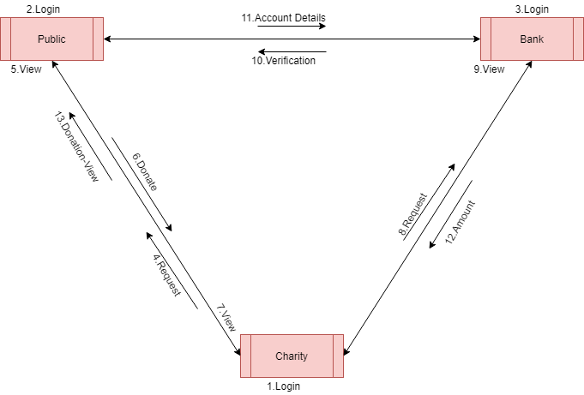
COLLABORATION DIAGRAM

Slide 11
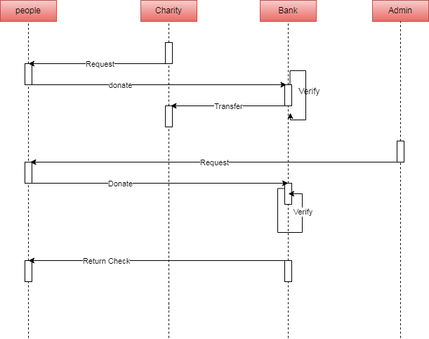
SEQUENCE DIAGRAM:
Hacker

Slide 12
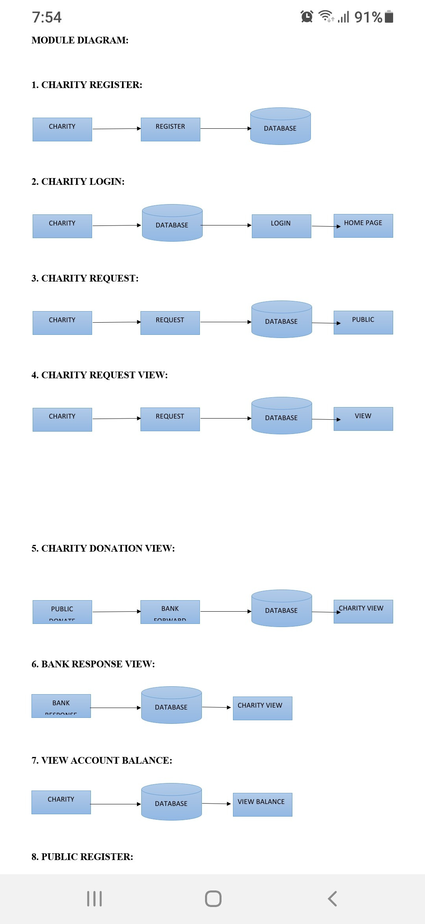
MODULE DESCRIPTION
1.CHARITY REGISTER:
The register module provides a conceptual framework for entering data on those charity in a way that: eases data entry & accuracy by matching the charity entry to the data source (usually paper files created at point of care), ties easily back to individual charity records to connect registers to charity data, and collects data elements to enable better supervision of donation programs.
2.CHARITY LOGIN
Add a subheading In this module in our project, here symbolizes a unit of work performed within a database management system (or similar system) against a database, and treated in a coherent and reliable way independent of other transactions. A transaction generally represents any change in database user will transfer the amount to provider.

Slide 13
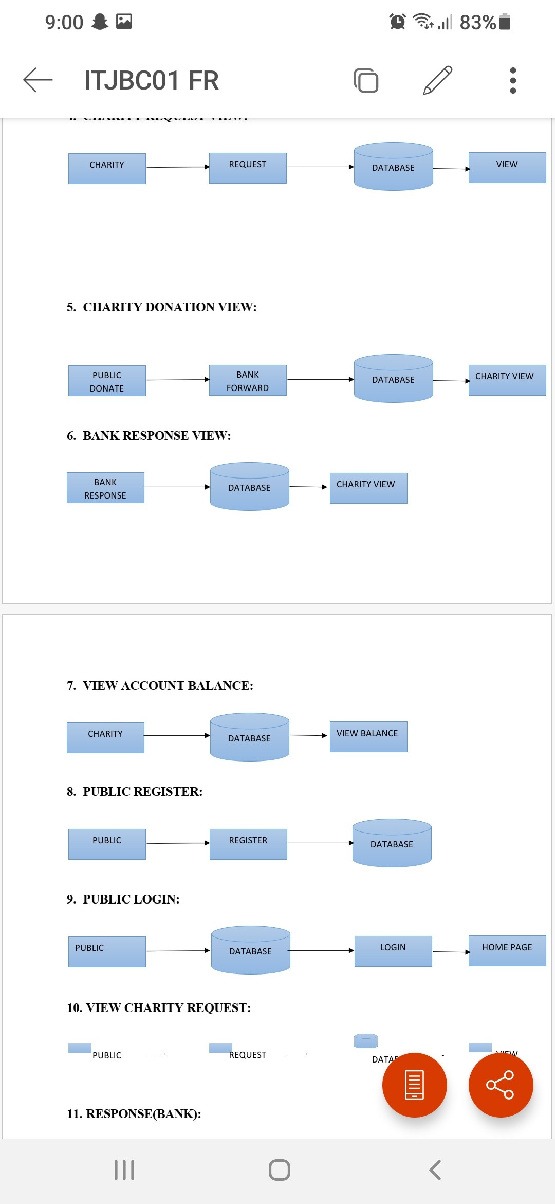
3. CHARITY REQUEST:
In this module is used to help to the user to Request for donation with the land longitude and the user will update the report along with their opinion and the will be stored the database.
4.CHARITY REQUEST VIEW:
In this module the charity will also view the request. And analysis the details will be responsible for your file stored in database.
5.CHARITY DONATION VIEW:
In this module the charity will also view the donation. And analysis the details will be responsible for your file stored in database.

Slide 14
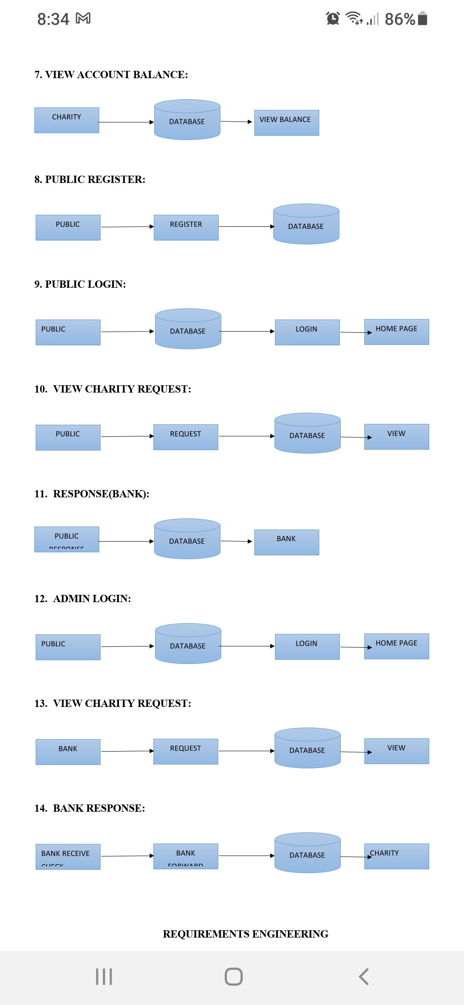
6. BANK RESPONSE VIEW:
In this module the charity will also view the donation. And analysis the details will be responsible for your file stored in database.
7.VIEW ACCOUNT BALANCE:
In this module the charity will also view the account balance. And analysis the details will be responsible for your file stored in database.
8.PUBLIC REGISTER:
The register module provides a conceptual framework for entering data on those charity in a way that: eases data entry & accuracy by matching the charity entry to the data source (usually paper files created at point of care), ties easily back to individual charity records to connect registers to charity data, and collects data elements to enable better supervision of donation programs.

Slide 15
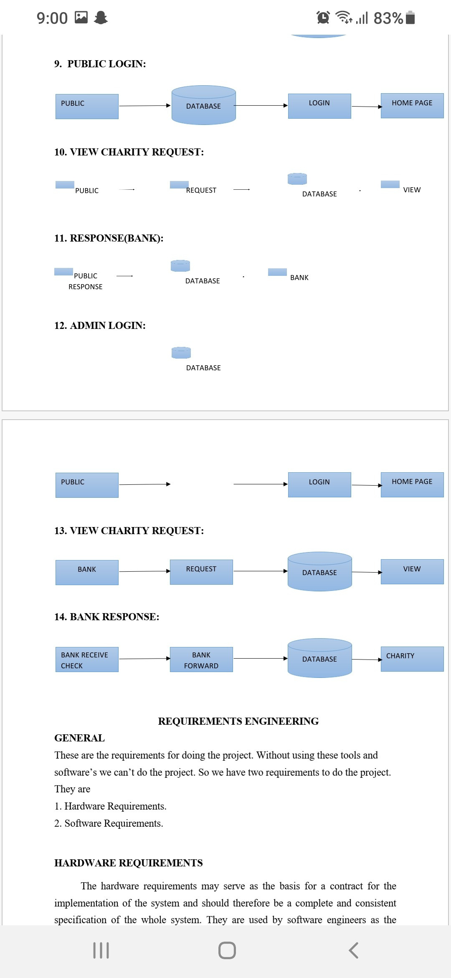
9.PUBLIC LOGIN:
In this module in our project, here symbolizes a unit of work performed within a database management system (or similar system) against a database, and treated in a coherent and reliable way independent of other transactions. A transaction generally represents any change in database user will transfer the amount to provider.
10. RESPONSE:
In this module the bank will response the data file fully analyzed data in category wise view Bank will be responsible for your file stored in database.

Slide 16
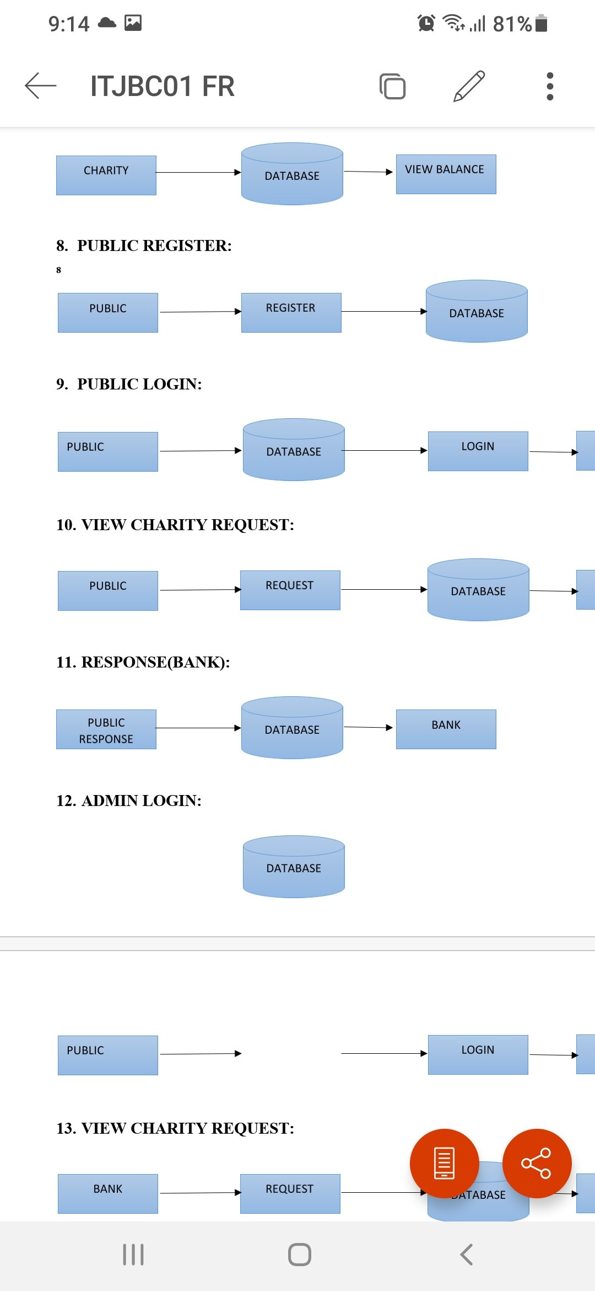
11.RESPONSE (BANK):
In this module is used to help to the public to donation the amount with the land longitude and the public will update the report along with their opinion and the will be stored the database.
12.ADMIN LOGIN:
In this module in our project, here symbolizes a unit of work performed within a database management system (or similar system) against a database, and treated in a coherent and reliable way independent of other transactions. A transaction generally represents any change in database user will transfer the amount to provider.

Slide 17
SYSTEM TESTING
CHARITY MANGEMENT:
S.NO | ACTION TO PERFORM | EXCEPECTED RESULTS | ACTUAL RESULTS | RESULT(PASS/FAIL)
1 | Login | Fill the user name and password | As Excepted | Pass
2 | Charity approved | Verify the details of charity | As Excepted | Pass
3 | Allocate public | Verify the details of public | As Excepted | Pass
CHARITY:
S.NO | ACTION TO PERFORM | EXCEPECTED RESULTS | ACTUAL RESULTS | RESULT(PASS/FAIL)
1 | Register | Fill the given details | As Excepted | Pass
2 | Login | Fill the user name and password | As Excepted | Pass
3 | Charity request | Request for donation | As Excepted | Pass
4 | View cheque | View the cheque and transfer to the bank | As Excepted | Pass

Slide 18
PUBLIC :
S.NO | ACTION TO PERFORM | EXCEPECTED RESULTS | ACTUAL RESULTS | RESULT(PASS/FAIL)
1 | Register | Fill the given details | As Excepted | Pass
2 | Login | Fill the user name and password | As Excepted | Pass
3 | View the request | Public views the request by the charity | As Excepted | Pass
4 | Willing to donate | Public make the donation | As Excepted | Pass
5 | Response from bank | Verification from the bank | As Excepted | Pass
BANK :
S.NO | ACTION TO PERFORM | EXCEPECTED RESULTS | ACTUAL RESULTS | RESULT(PASS/FAIL)
1 | Login | Fill the user name and password | As Excepted | Pass
2 | View and verify the cheque | Cheque will be view by bank and verify from public | As Excepted | Pass
3 | Verified | Amount will be transferred to charity | As Excepted | Pass
4 | Not verified | Cheque will be encrypted | As Excepted | Pass

Slide 19

SCREENSHOTS
MAIN PAGE

Slide 20

CHARITY MAIN PAGE

Slide 21
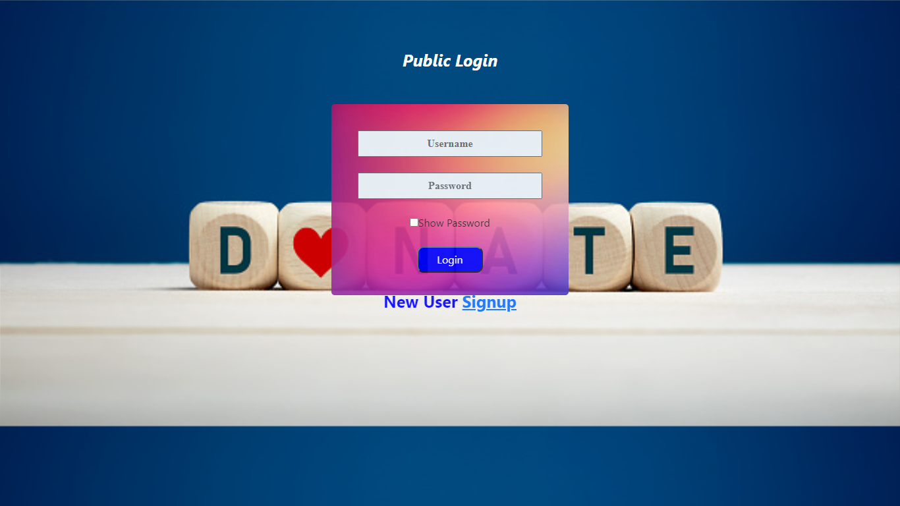
PUBLIC LOGIN PAGE

Slide 22
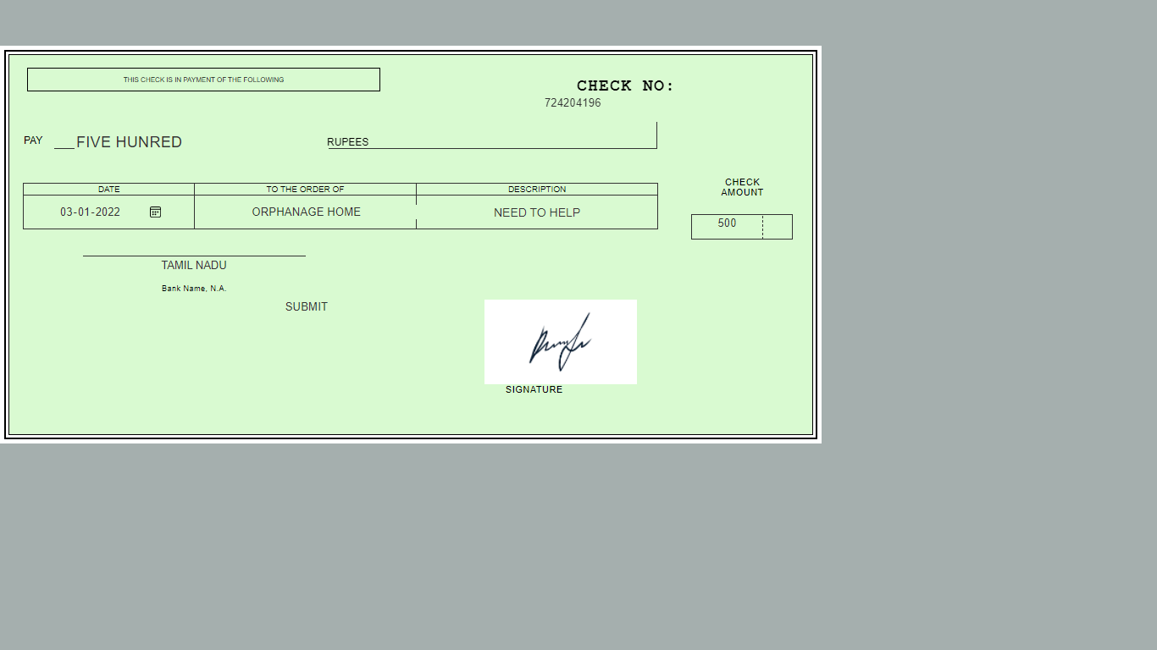
CHEQUE VIEW PAGE

Slide 23
CONCLUSION
Banking scams involve attempts to access your bank account.
Use this information to recognize, report, and protect yourself from them.
These scams work because fake checks generally look just like real checks, even to bank employees.
They are often printed with the names and addresses of legitimate financial institutions.
They may even be real checks written on bank accounts that belong to identity
theft victims.
It can take for a bank to figure out that the check is a fake.

Slide 24
REFERENCE
[1] Badis Hammi , Sherali Zeadally , Yves Christian Elloh Adja, Manlio Del Giudice, and Jamel Nebhen,2021, “Blockchain-Based Solution for Detecting and Preventing Fake Check Scams”.
[2] Emart 77, Beirut, Lebanon,2021,“ The Role of Blockchain in Reducing the Cost of Financial Transactions in the Retail Industry”.
[3] Dilip Kumar Sharma; Sonal Garg; Priya Shrivastava ,2021,“ Evaluation of Tools and Extension for Fake News Detection”.
[4] Vikash Kumar Aggarwal , Nikhil Sharma , Ila Kaushik , Bharat Bhushan , Himanshu, 2020, “Integration of Blockchain and IoT (B-IoT): Architecture, Solutions, & Future Research Direction”.
[5] Jackie Jones, Damon McCoy,2020,“The Check is in the Mail: Monetization of Craigslist Buyer Scams”.
[6] Abiola, Idowu,2019,“ An Assessment of Fraud and its Management in Nigeria Commercial Banks”.
[7] Sumeet Kumar,2018, “Simulating DDOS attacks on the us fiber-optics internet infrastructure”.
[8]Nazli Ismail Nawang,2017, “Combating anonymous offenders in the cyberspace: An overview of the legal approach in Malaysia”.
[9]Haris Šemić, Sasa Mrdovic,2017, “IoT honeypot: A multi-component solution for handling manual and Mirai-based attacks”.
[10] Bernie S. Fabito, Angelique D. Lacasandile, Emeliza R. Yabut ,2017,“ : Leveraging crime reporting in Metro Manila using unsupervised crowd-sourced data: A case for the Report framework”.
[11] Wendy Baker-Smemoe, Chair David Eddington William G. Eggington,2015,“ The Language and Cross-Cultural Perceptions of Deception”.
[12] S. Baker, 2018, “Don’t cash that cheque: BBB study shows how fake cheque scams bait consumers”, Tech. Rep., Better Bus. Bureau, Arlington County, VA, USA, Sep.
[13] L. M. Rose, 2018, “Modernizing cheque fraud detection with machine learning”, Ph.D. dissertation, Dept. Financial Crime Compliance Manage., Utica College, Utica, NY, USA.
[14] Federal Trade Commission, 2018, “Consumer sentinel network data book 2017”, FederalTrade Commission,Washington, DC, USA,Tech. Rep., Mar.
[15] C. Tressler, 2020, “FTC: The bottom-line on fake cheques scams”, Federal Trade Commission, Washington, DC, USA, Tech. Rep., Feb.
[16] “2017 Internet crime report,” Federal Bureau of Investigation/Internet Crime Complaint Center, Washington, DC, USA, Tech. Rep., 2018.
[17] K. Pak and D. Shadel, 2011, “AARP Foundation national fraud victim study”, AARP Foundation, Washinton, DC, USA, Tech. Rep..
[18] C.-D. Chen and L.-T. Huang, 2011, “Online deception investigation: Content analysis and cross-cultural comparison”, Int. J. Bus. Inf., vol. 6, no. 1, pp. 91–111.
[19] K. Christidis and M. Devetsikiotis, 2016 “Blockchains and smart contracts for the Internet of Things”, IEEE Access, vol. 4, pp. 2292–2303.
[20] A. Reyna, C. Martín, J. Chen, E. Soler, and M. Díaz, 2018 “On blockchain and its integration with IoT: Challenges and opportunities”, Future Gener. Comput. Syst., vol. 88, pp. 173–190.

Slide 25
THANK YOU

